Slide 1
Energy and Work

Slide 2
Learning Objectives
I can define Kinetic and Potential energy.
I can identify Kinetic and Potential energy.
I can give examples of the two forms of energy.
I can explain how one can transfer to the other.
Notes:
In this lesson, students will learn the definitions of both potential and kinetic energy. They will also be able to give examples of each and explain how potential energy changes into kinetic energy.

Slide 3
Work
The product of distance and the force in the direction an object moves.
Work = Force x Distance

Slide 4

Definition of Energy…
The ability or capacity to do work.
Measured by the capability of doing work:
potential energy
or
the conversion of this capability to motion:
kinetic energy.
Notes:
In order to understand the different forms of energy, you have to know what the term “energy” means. Energy is the ability or the capacity of an object to do work. This is measured in two different ways : capability of doing work- known as potential energy, and the conversion of the capability to motion- called kinetic energy.

Slide 5
What is Energy?
  The ability to cause change
    Think about things that have energy “in them”…
    All those things can make something DO something!
  It’s what causes change in everything!
    Nothing changes without some energy causing it.
    Earthquakes, Rain, even human growth is all because of energy.

Slide 6

Kinetic and Potential Energy
2 types of energy
Notes:
Today we are going to learn about Kinetic and Potential energy.

Slide 7
How is all energy divided?
All Energy
Potential
Energy
Kinetic
Energy
Gravitation
Potential
Energy
Elastic
Potential
Energy

Slide 8

Potential Energy
Energy that is stored due to position or shape. It is stored energy.
There are 2 types of Potential Energy
1) Gravitational Potential Energy (GPE)
2) Elastic Potential Energy
Notes:
The first form of energy is Potential energy. This is energy due to position.. Its also known as “stored energy.” To calculate PE you take the object’s weight and multiply it by the earths gravitational pull and the distance the object can fall.

Slide 9
Gravitational Potential Energy (GPE)
Potential Energy that depends upon an objects height above a reference point
Formula:
PE = mgh
Potential energy is calculated by:
The object’s mass (m), multiplied by the earth’s gravitational pull (g) (9.8 m/sec/sec), multiplied by the height (h) the object can fall.
Notes:
The first form of energy is Potential energy. This is energy due to position.. Its also known as “stored energy.” To calculate PE you take the object’s weight and multiply it by the earths gravitational pull and the distance the object can fall.

Slide 10
Formula Representation
Formula | Represents | Units
PE = mgh | m = | Kilogram (kg)
 | g = acceleration due to gravity | m/s/s
 | h = height | Meter (m)
mass

Slide 11

Gravitational Potential Energy
Books on a shelf have Gravitational Potential Energy.
Which books have the most Gravitational Potential Energy? Why?

Slide 12
Gravitational Potential Energy
A man and his cell phone are on a ledge outside a very tall building.
Which object (the man or his cell phone) has the most Gravitational Potential Energy? Why?

Slide 13
What does Potential Energy depend on and how does it affect potential energy?
Height – The higher the object, the more potential energy.
Mass – The greater the mass of the object, the more potential energy it has.
Potential energy depends on both mass and height.

Slide 14
Examples of Gravitational Potential Energy
Water at the top of a waterfall..
-Stores energy
Yo–Yo in held in your hand..
-Stores energy because of position

Slide 15
Elastic Potential Energy (EPE)
The potential energy of an object that is stretched or compressed.
Examples of Elastic Potential Energy
Stretching a rubber band..
-Stores energy
Drawing a Bow…
-Stores energy because of position
Notes:
The first form of energy is Potential energy. This is energy due to position.. Its also known as “stored energy.” To calculate PE you take the object’s weight and multiply it by the earths gravitational pull and the distance the object can fall.

Slide 16
Elastic Potential Energy
The bow has energy because work has been done to change its shape.
The energy of that work is turned into potential energy.
When the arrow is released the potential energy of the bow and string will be transferred to the arrow, sending it flying through the air.

Slide 17
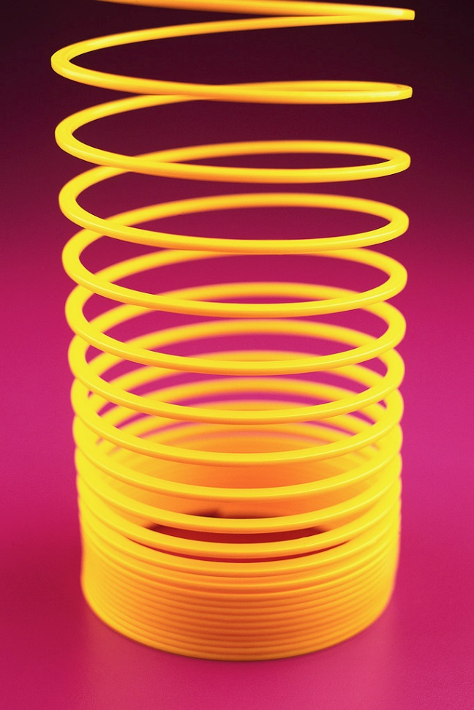
Elastic Potential Energy
Compressed, or squished, springs also have potential energy.
A spring has energy because work has been done to change its shape.
Just like the bow, the energy of that work is turned into potential energy.

Slide 18

Elastic Potential Energy
What about rubber bands and other things that stretch?
Elastic Potential Energy

Slide 19
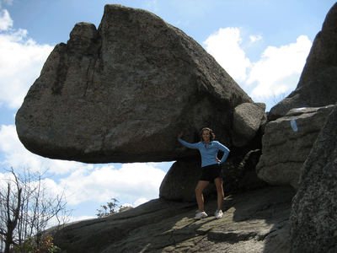
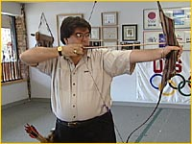
There are two “types” of Potential energy:
Potential: “stored” energy (able or about to do something but isn’t just yet)
The ball could fall,
but it hasn’t yet!
There are two basic examples
of Potential Energy:
Gravitational
Elastic
The boulder can fall but it hasn’t yet
The “bow” can shoot the arrow
but isn’t right now.
Elastic Energy is caused by changing the shape of an object
(“stretching”, “bending”, “pulling”, “squishing”)
Gravitational Energy is caused by the force of gravity
Pulling down on an object while the object is being held up!

Slide 20
When the position of an object is altered it, creates Potential Energy.
A yo-yo on the table, doesn’t have energy, but when picked up, it alters its position and now it has the ability (or potential) to do work.
A bow doesn’t have the capacity to do work, unless it’s held at an elevated position.
Notes:
Almost every object has the potential to do work, or store energy, but the objects original position needs to be altered so it can eventually move.
For example: If the Yo-Yo we used in example one was just sitting of a table, it doesn’t have potential energy because the object by itself doesn’t have the capability to do work or move. If you pick the Yo-Yo up off the table, it now has altered its original position, and can store energy because it can now work with your help.

Slide 21


Potential Energy Converted to Kinetic Energy…
When stored energy begins to move, the object now transfers from potential energy into kinetic energy.
Standing still
Running
Notes:
Potential energy eventually will need to transfer from it’s stored energy into motion. If a person is standing still, they obtain potential energy because the have the ability to walk or run… if the same person who is standing still decides to start running, then they have transferred their PE into KE… in other words, they went from storing energy, to moving energy.

Slide 22
Kinetic Energy Preview
Kinetic Energy is the energy of motion or energy in use
Any matter in motion has Kinetic Energy
There are many forms of Kinetic Energy
Some forms include: electromagnetic (light - radiant), thermal (heat), electrical, and mechanical (sound – acoustic)

Slide 23

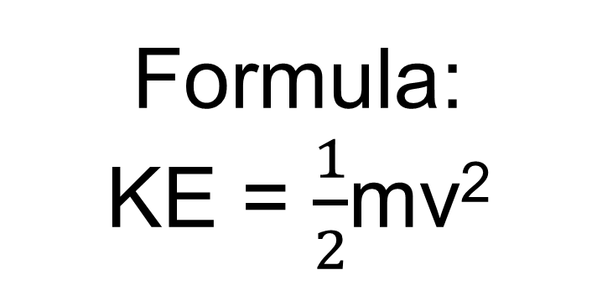
Kinetic Energy Definition and Formula
The energy an object has due to its motion
Formula:
KE = $\frac{1}{2}$mv²
Kinetic energy is calculated by:
Squaring the velocity (v), multiply by the object’s mass (m), than divided by 2.
Notes:
The first form of energy is Potential energy. This is energy due to position.. Its also known as “stored energy.” To calculate PE you take the object’s weight and multiply it by the earths gravitational pull and the distance the object can fall.

Slide 24
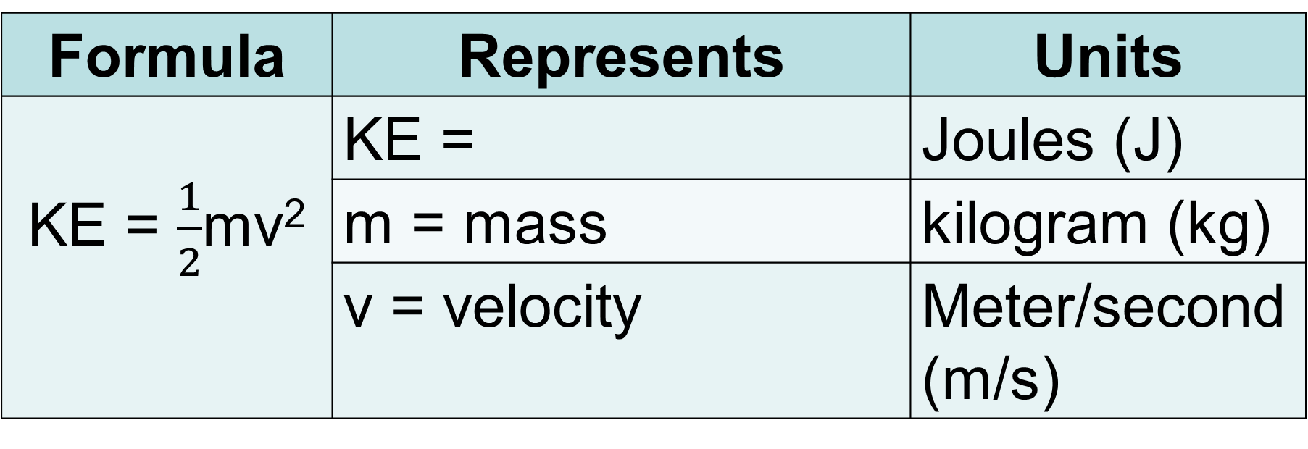
Formula Representation
Formula | Represents | Units
KE = $\frac{1}{2}$mv² | KE = | Joules (J)
 | m = mass | kilogram (kg)
 | v = velocity | Meter/second (m/s)
Kinetic Energy

Slide 25
Kinetic energy:
Kinetic: Energy of movement
This container is
full of a red liquid
But there is a hole!
Gravity pulls the
liquid down through
the hole!
The motion of the liquid is
an example of a substance
with Kinetic Energy
Ball falling down = Movement
Movement = Kinetic Energy

Slide 26
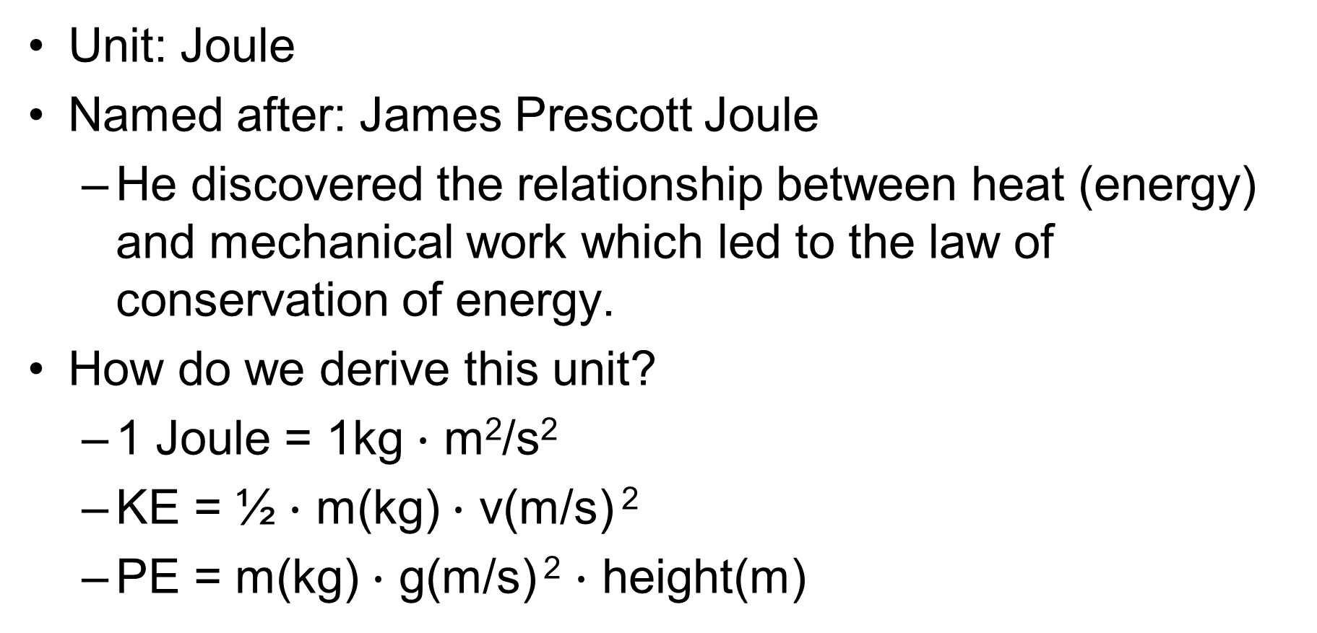
What is the unit for Kinetic and Potential Energy?
Unit: Joule
Named after: James Prescott Joule
  He discovered the relationship between heat (energy) and mechanical work which led to the law of conservation of energy.
How do we derive this unit?
  1 Joule = 1kg $∙$ m²/s²
  KE = ½ $∙$ m(kg) $∙$ v(m/s) ²
  PE = m(kg) $∙$ g(m/s) ² $∙$ height(m)

Slide 27
What does Kinetic Energy depend on and how does it affect kinetic energy?
Velocity/Speed – The faster the object moves, the more kinetic energy it has.
Mass – The greater the mass of a moving object, the more kinetic energy it has.
Kinetic energy depends on both mass and velocity.

Slide 28
Which affects kinetic energy more? Mass or Velocity and why?
Velocity has more of an affect on kinetic energy because the velocity is squared.

Slide 29




Examples of Kinetic Energy
Shooting a rubber band.
Water falling over the fall.
A Yo-Yo in motion.
Releasing the arrow from the bow.
Notes:
Using the same examples as potential energy, you can see how the same object that previously had PE now has KE. If the rubber band we were stretching to give it PE, were to be let go, it would now have KE because its now in motion.
Same with the water in the waterfall, when it falls over, its now in motion.
The Yo-Yo and the arrow from the bow are also moving, giving all these objects KE.

Slide 30
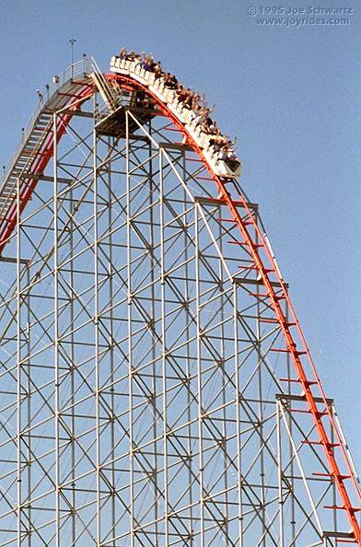


Potential vs. Kinetic:
The Roller Coaster has
potential energy at the
top of the hill
The rocket has potential energy
when the fuel hasn’t been lit
The rocket has Kinetic
energy when it’s fuel is
lit and it flies through the air
Wow!
There’s a lot of potential energy in this sucker!
But it has Kinetic energy
when it rolls down the hill!

Slide 31
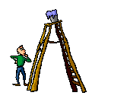
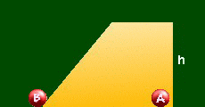
POTENTIAL ENERGY
Energy stored or held in readiness
Most potential

Slide 32
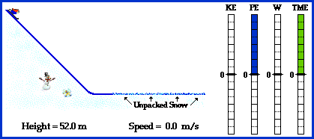
THE TRADE OFF Between Potential & Kinetic Energy

Slide 33
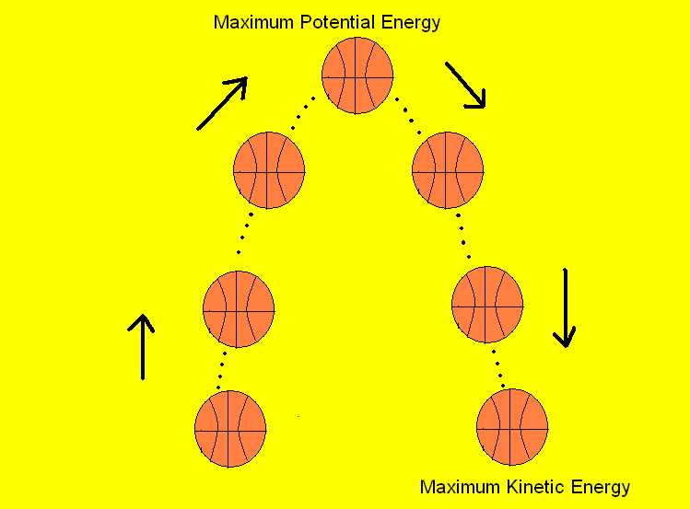
As a basketball player throws the ball into the air, various energy conversions take place.

Slide 34
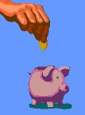
Summary of What You’ve Learned..
Example using a coin:
Holding a coin in you hand, alters the coins original position.
The coin has potential energy, because it has ability to do work.
Dropping the coin in the bank, changes the stored energy into motion.
This transfers the coin’s energy from potential to kinetic energy.
Notes:
This is a example using everything we just learned, but using one object.
If you take a coin, and hold it in your hand you are altering it’s original position.
This gives the coin PE because it now has the ability to do work, or in this example drop.
When you let go of the coin, it transfers its stored energy into motion.
This is converting PE into KE.

Slide 35
Big Ideas
2 main types of energy: Kinetic and Potential
Kinetic energy is energy of motion and depends on mass and velocity.
Potential energy is stored energy
Potential energy has 2 types: Gravitational and Elastic
Gravitational potential energy depends on mass and height.

